Slide 1
Refactoring

Slide 2
Understanding Smells
Notes:
Let’s move on to something kind of stinky – smells! There are process smells and code smells and situation smells and all sorts of smells.

Slide 3
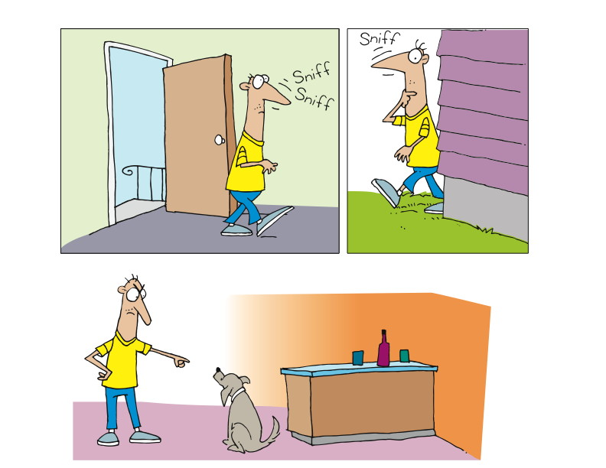
Notes:
Read definition
Walk into your home and something doesn’t smell right.
You walk around to try to find the culprit. Garbage, Laundry, Fido?
Smells are subtle
The smell is not the problem, its what’s causing the smell
Once you identify it, you can do something about it.
------------------------------------------------------------------------------------------------------------------------
As usual, let’s start with a defnition:
“In computer programming, code smell is any symptom in the source code of a program that possibly indicates a deeper problem.
“Often the deeper problem hinted by a code smell can be uncovered when the code is subjected to a short feedback cycle where it is refactored in small, controlled steps, and the resulting design is examined to see if there are any further code smells that indicate the need of more refactoring. From the point of view of a programmer charged with performing refactoring, code smells are heuristics to indicate when to refactor, and what specific refactoring techniques to use. Thus, a code smell is a driver for refactoring.”
http://en.wikipedia.org/wiki/Code_smell
[CLICK]
To get the idea of smells, imagine walking into your home, and you realize that something stinks. Literally. You smell something, and you know it’s not right, but you’re not sure what it is. Gas? Garbage? Dirty laundry? Whatever it is, it’s the smell that leads you to explore and eventually to discover the source of the smell.
Smells are subtle, in that it’s not the smell itself that’s the problem, but rather what the smell indicates about something deeper or bigger.
Once you’ve discovered the source of a smell, you can do something about it.

Slide 4
Examples of Code Smells
Long Methods
Explaining Comments
Magic Numbers
Notes:
Remember that Smells are merely a way to recognize potential refactorings
Long Methods suggest Extract Method
Explaining Comments – suggest extract method and remove comments
Magic Numbers - An unnamed or ill-documented numerical constant value. From wikipedia.
“Refactoring to Patterns” by Joshua Kerievsky is an excellent resource for developers looking for ways to identify smells and their suggested refactorings

Slide 5
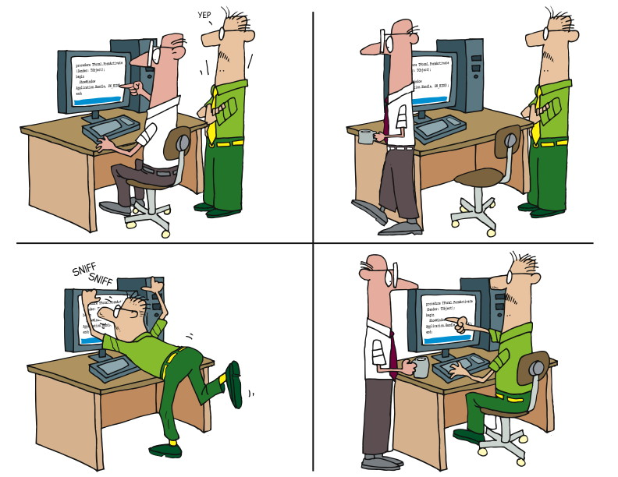
Pairing and Smells
Notes:
Let’s go back to the hygiene issue
You work out. You can’t really smell yourself, because you’ve been – immersed in it.
Consider what happens when you work by yourself.
You may not notice the smells you are creating.
Pairing helps
Looking back at our discussion about pairing, we can see where smells come into play.
Forgive the somewhat graphic discussion, but consider what happens when you exercise. Typically, if you’re exercising hard, or working hard, you’ll sweat. When you sweat, you sometimes produce an unpleasant odor. And yet we generally cannot smell our own odor at that time, because we’ve been – if you will – immersed in it.
Now consider what happens when you work by yourself. You might do something that’s just a little bit less than optimal. Then as you continue to build on that, the suboptimization subtly increases, you being all unaware because you’ve been immersed in it all along.
Just as with the gentle aroma that comes from heavy exercise, you may be producing code smells. Without the presence of someone else to – sniff – help you identify those smells, you might go along happily thinking all is good. That’s where pairing comes in.

Slide 6
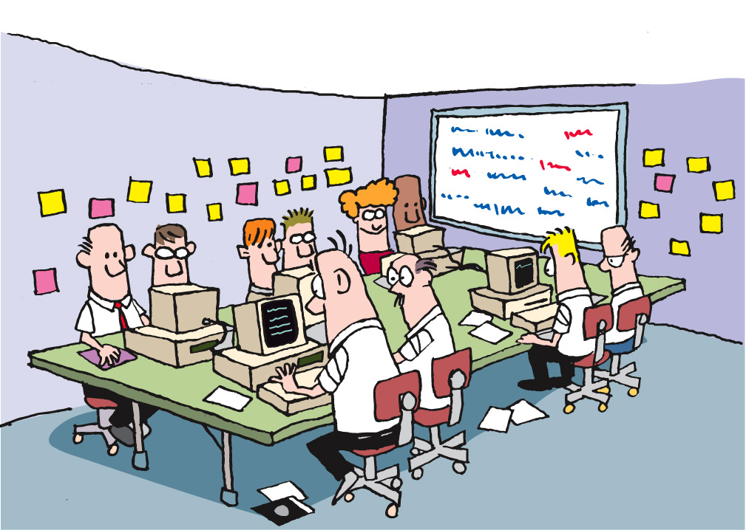
Plan/Manage
LEGO
Dev
Fun
Core
Origins
Intro
Agenda
Notes:
Team smells
Someone with headphones
May not be a smell, but worth investigating
Same pair all the time
Regular issues with one BA’s stories
-----------------------------------------------------------------------------------------
Let’s also consider a different form of smell – team smells. Imagine that you have a collocated team. As you walk into the team room, you notice that one member of the team has headphones on and is bopping along to some music that only they can hear. Everyone seems happy, most of the team is pairing, work is getting done, and yet…
That team member with the headphones on is a team smell. Why? One of the keys to success on an agile team is ongoing communication and osmotic learning. Osmotic learning is the learning that takes place when conversations and discussions are going on, and I learn just by overhearing. And, of course, I may hear something that stimulates me to jump in and contribute. The team dynamics on Agile teams are exciting, because there’s so much communication going on.
So if you have a team member with headphones on, they’re disconnected from the rest of the team, isolated from any osmotic learning, and not contributing to the life of the team.
It’s not NECESSARILY a bad thing. But as with any smell, it’s worth investigating.

Slide 7
Refactoring
Plan/Manage
LEGO
Dev
Fun
Core
Origins
Intro
Agenda

Slide 8
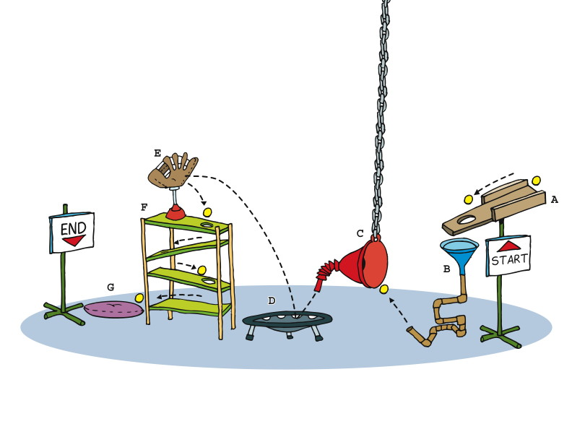
Plan/Manage
LEGO
Dev
Fun
Core
Origins
Intro
Agenda
Notes:
Refactoring
“In software engineering, ‘refactoring’ source code means improving it without changing its overall results, and is sometimes informally referred to as ‘cleaning it up’. Refactoring neither fixes bugs nor adds new functionality, though it might precede either activity. Rather, it improves the understandability of the code, changes its internal structure and design, and removes dead code.
“These changes are intended to make the code easier to comprehend, more maintainable, and more amenable to change. Refactoring is usually motivated by the difficulty of adding new functionality to a program or fixing a bug in it.”
http://en.wikipedia.org/wiki/Refactoring
“In computer programming, code smell is any symptom in the source code of a program that possibly indicates a deeper problem.
“Often the deeper problem hinted by a code smell can be uncovered when the code is subjected to a short feedback cycle where it is refactored in small, controlled steps, and the resulting design is examined to see if there are any further code smells that indicate the need of more refactoring. From the point of view of a programmer charged with performing refactoring, code smells are heuristics to indicate when to refactor, and what specific refactoring techniques to use. Thus, a code smell is a driver for refactoring.”
http://en.wikipedia.org/wiki/Code_smell
Understand code smells before understanding refactoring
Concept: Code smells represented by real smells
Frames (separate, so they can appear on separate slides):
Man walks into house, raises head and sniffs the air
Man walking around house, sniffing
Man standing by kitchen counter/island, looking at dog, shaking finger at dog (implied smelliness hidden from view)
Strip:
Programmer1 banging away on keyboard, code on monitor
Programmer1 pointing to monitor, Programmer2 nodding
Programmer1 walks away, Programmer2 sits at keyboard and monitor
Programmer2 looks puzzled, sniffing for smell
Programmer1 looking over Programmer2’s shoulder, Programmer2 pointing at monitor
Refactoring is about making it cleaner, more understandable, more maintainable
Concept: Some kind of Rube Goldberg machine
Frames:
First view of machine – ball starts at one end, goes through all sorts of weird stuff, comes out the other end – chute at start end feeds ball into machine, fades/blurs off image, receiving chute at other end, same kind of fade/blur
Woman (workmanlike, maybe with tool belt?) looking at machine, considering, maybe hand on cheek
Woman removing parts, connecting other/remaining parts – start and end remain the same, ball moves through from start to finish
Woman removing more parts, connecting remaining parts – start and end remain the same, ball moves through from start to finish
Woman removes more parts, connecting start to end with a simple chute – start and end chutes remain the same – woman looking satisfied, ball moves through from start to finish

Slide 9
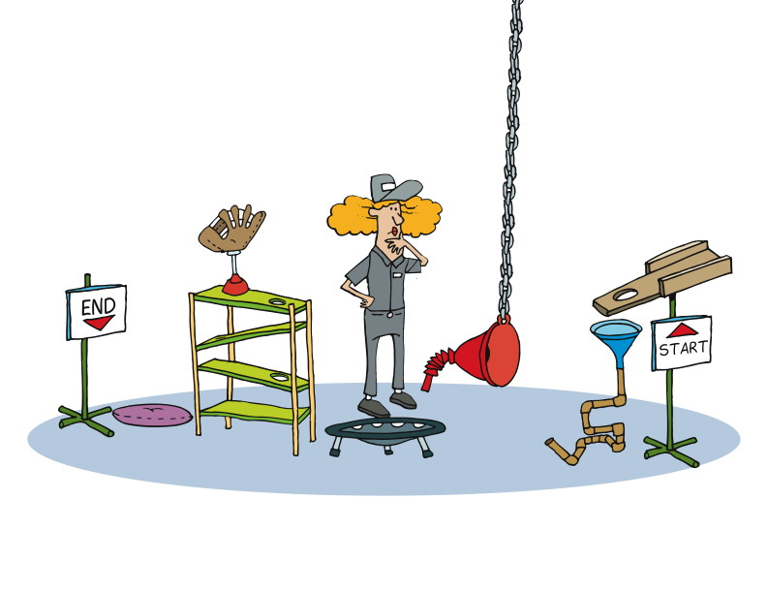
Plan/Manage
LEGO
Dev
Fun
Core
Origins
Intro
Agenda
Notes:
Refactoring
“In software engineering, ‘refactoring’ source code means improving it without changing its overall results, and is sometimes informally referred to as ‘cleaning it up’. Refactoring neither fixes bugs nor adds new functionality, though it might precede either activity. Rather, it improves the understandability of the code, changes its internal structure and design, and removes dead code.
“These changes are intended to make the code easier to comprehend, more maintainable, and more amenable to change. Refactoring is usually motivated by the difficulty of adding new functionality to a program or fixing a bug in it.”
http://en.wikipedia.org/wiki/Refactoring
“In computer programming, code smell is any symptom in the source code of a program that possibly indicates a deeper problem.
“Often the deeper problem hinted by a code smell can be uncovered when the code is subjected to a short feedback cycle where it is refactored in small, controlled steps, and the resulting design is examined to see if there are any further code smells that indicate the need of more refactoring. From the point of view of a programmer charged with performing refactoring, code smells are heuristics to indicate when to refactor, and what specific refactoring techniques to use. Thus, a code smell is a driver for refactoring.”
http://en.wikipedia.org/wiki/Code_smell
Understand code smells before understanding refactoring
Concept: Code smells represented by real smells
Frames (separate, so they can appear on separate slides):
Man walks into house, raises head and sniffs the air
Man walking around house, sniffing
Man standing by kitchen counter/island, looking at dog, shaking finger at dog (implied smelliness hidden from view)
Strip:
Programmer1 banging away on keyboard, code on monitor
Programmer1 pointing to monitor, Programmer2 nodding
Programmer1 walks away, Programmer2 sits at keyboard and monitor
Programmer2 looks puzzled, sniffing for smell
Programmer1 looking over Programmer2’s shoulder, Programmer2 pointing at monitor
Refactoring is about making it cleaner, more understandable, more maintainable
Concept: Some kind of Rube Goldberg machine
Frames:
First view of machine – ball starts at one end, goes through all sorts of weird stuff, comes out the other end – chute at start end feeds ball into machine, fades/blurs off image, receiving chute at other end, same kind of fade/blur
Woman (workmanlike, maybe with tool belt?) looking at machine, considering, maybe hand on cheek
Woman removing parts, connecting other/remaining parts – start and end remain the same, ball moves through from start to finish
Woman removing more parts, connecting remaining parts – start and end remain the same, ball moves through from start to finish
Woman removes more parts, connecting start to end with a simple chute – start and end chutes remain the same – woman looking satisfied, ball moves through from start to finish

Slide 10
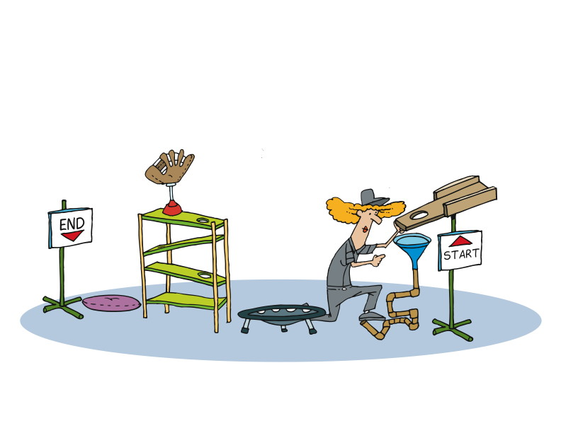
Plan/Manage
LEGO
Dev
Fun
Core
Origins
Intro
Agenda
Notes:
Refactoring
“In software engineering, ‘refactoring’ source code means improving it without changing its overall results, and is sometimes informally referred to as ‘cleaning it up’. Refactoring neither fixes bugs nor adds new functionality, though it might precede either activity. Rather, it improves the understandability of the code, changes its internal structure and design, and removes dead code.
“These changes are intended to make the code easier to comprehend, more maintainable, and more amenable to change. Refactoring is usually motivated by the difficulty of adding new functionality to a program or fixing a bug in it.”
http://en.wikipedia.org/wiki/Refactoring
“In computer programming, code smell is any symptom in the source code of a program that possibly indicates a deeper problem.
“Often the deeper problem hinted by a code smell can be uncovered when the code is subjected to a short feedback cycle where it is refactored in small, controlled steps, and the resulting design is examined to see if there are any further code smells that indicate the need of more refactoring. From the point of view of a programmer charged with performing refactoring, code smells are heuristics to indicate when to refactor, and what specific refactoring techniques to use. Thus, a code smell is a driver for refactoring.”
http://en.wikipedia.org/wiki/Code_smell
Understand code smells before understanding refactoring
Concept: Code smells represented by real smells
Frames (separate, so they can appear on separate slides):
Man walks into house, raises head and sniffs the air
Man walking around house, sniffing
Man standing by kitchen counter/island, looking at dog, shaking finger at dog (implied smelliness hidden from view)
Strip:
Programmer1 banging away on keyboard, code on monitor
Programmer1 pointing to monitor, Programmer2 nodding
Programmer1 walks away, Programmer2 sits at keyboard and monitor
Programmer2 looks puzzled, sniffing for smell
Programmer1 looking over Programmer2’s shoulder, Programmer2 pointing at monitor
Refactoring is about making it cleaner, more understandable, more maintainable
Concept: Some kind of Rube Goldberg machine
Frames:
First view of machine – ball starts at one end, goes through all sorts of weird stuff, comes out the other end – chute at start end feeds ball into machine, fades/blurs off image, receiving chute at other end, same kind of fade/blur
Woman (workmanlike, maybe with tool belt?) looking at machine, considering, maybe hand on cheek
Woman removing parts, connecting other/remaining parts – start and end remain the same, ball moves through from start to finish
Woman removing more parts, connecting remaining parts – start and end remain the same, ball moves through from start to finish
Woman removes more parts, connecting start to end with a simple chute – start and end chutes remain the same – woman looking satisfied, ball moves through from start to finish

Slide 11
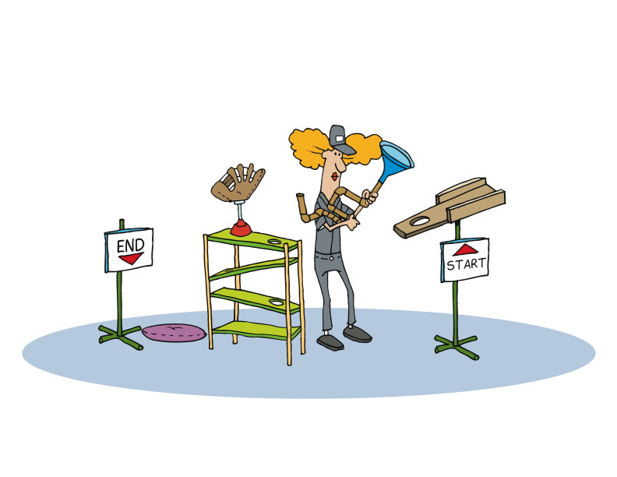
Plan/Manage
LEGO
Dev
Fun
Core
Origins
Intro
Agenda
Notes:
Refactoring
“In software engineering, ‘refactoring’ source code means improving it without changing its overall results, and is sometimes informally referred to as ‘cleaning it up’. Refactoring neither fixes bugs nor adds new functionality, though it might precede either activity. Rather, it improves the understandability of the code, changes its internal structure and design, and removes dead code.
“These changes are intended to make the code easier to comprehend, more maintainable, and more amenable to change. Refactoring is usually motivated by the difficulty of adding new functionality to a program or fixing a bug in it.”
http://en.wikipedia.org/wiki/Refactoring
“In computer programming, code smell is any symptom in the source code of a program that possibly indicates a deeper problem.
“Often the deeper problem hinted by a code smell can be uncovered when the code is subjected to a short feedback cycle where it is refactored in small, controlled steps, and the resulting design is examined to see if there are any further code smells that indicate the need of more refactoring. From the point of view of a programmer charged with performing refactoring, code smells are heuristics to indicate when to refactor, and what specific refactoring techniques to use. Thus, a code smell is a driver for refactoring.”
http://en.wikipedia.org/wiki/Code_smell
Understand code smells before understanding refactoring
Concept: Code smells represented by real smells
Frames (separate, so they can appear on separate slides):
Man walks into house, raises head and sniffs the air
Man walking around house, sniffing
Man standing by kitchen counter/island, looking at dog, shaking finger at dog (implied smelliness hidden from view)
Strip:
Programmer1 banging away on keyboard, code on monitor
Programmer1 pointing to monitor, Programmer2 nodding
Programmer1 walks away, Programmer2 sits at keyboard and monitor
Programmer2 looks puzzled, sniffing for smell
Programmer1 looking over Programmer2’s shoulder, Programmer2 pointing at monitor
Refactoring is about making it cleaner, more understandable, more maintainable
Concept: Some kind of Rube Goldberg machine
Frames:
First view of machine – ball starts at one end, goes through all sorts of weird stuff, comes out the other end – chute at start end feeds ball into machine, fades/blurs off image, receiving chute at other end, same kind of fade/blur
Woman (workmanlike, maybe with tool belt?) looking at machine, considering, maybe hand on cheek
Woman removing parts, connecting other/remaining parts – start and end remain the same, ball moves through from start to finish
Woman removing more parts, connecting remaining parts – start and end remain the same, ball moves through from start to finish
Woman removes more parts, connecting start to end with a simple chute – start and end chutes remain the same – woman looking satisfied, ball moves through from start to finish

Slide 12
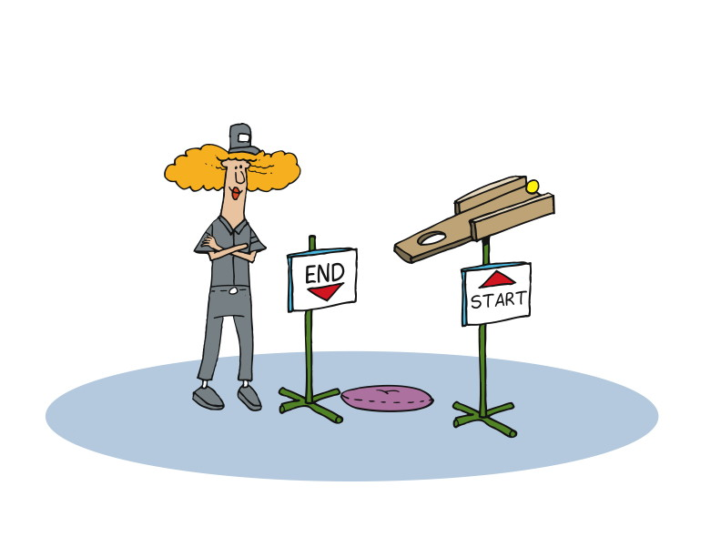
Plan/Manage
LEGO
Dev
Fun
Core
Origins
Intro
Agenda
Notes:
Refactoring
“In software engineering, ‘refactoring’ source code means improving it without changing its overall results, and is sometimes informally referred to as ‘cleaning it up’. Refactoring neither fixes bugs nor adds new functionality, though it might precede either activity. Rather, it improves the understandability of the code, changes its internal structure and design, and removes dead code.
“These changes are intended to make the code easier to comprehend, more maintainable, and more amenable to change. Refactoring is usually motivated by the difficulty of adding new functionality to a program or fixing a bug in it.”
http://en.wikipedia.org/wiki/Refactoring
“In computer programming, code smell is any symptom in the source code of a program that possibly indicates a deeper problem.
“Often the deeper problem hinted by a code smell can be uncovered when the code is subjected to a short feedback cycle where it is refactored in small, controlled steps, and the resulting design is examined to see if there are any further code smells that indicate the need of more refactoring. From the point of view of a programmer charged with performing refactoring, code smells are heuristics to indicate when to refactor, and what specific refactoring techniques to use. Thus, a code smell is a driver for refactoring.”
http://en.wikipedia.org/wiki/Code_smell
Understand code smells before understanding refactoring
Concept: Code smells represented by real smells
Frames (separate, so they can appear on separate slides):
Man walks into house, raises head and sniffs the air
Man walking around house, sniffing
Man standing by kitchen counter/island, looking at dog, shaking finger at dog (implied smelliness hidden from view)
Strip:
Programmer1 banging away on keyboard, code on monitor
Programmer1 pointing to monitor, Programmer2 nodding
Programmer1 walks away, Programmer2 sits at keyboard and monitor
Programmer2 looks puzzled, sniffing for smell
Programmer1 looking over Programmer2’s shoulder, Programmer2 pointing at monitor
Refactoring is about making it cleaner, more understandable, more maintainable
Concept: Some kind of Rube Goldberg machine
Frames:
First view of machine – ball starts at one end, goes through all sorts of weird stuff, comes out the other end – chute at start end feeds ball into machine, fades/blurs off image, receiving chute at other end, same kind of fade/blur
Woman (workmanlike, maybe with tool belt?) looking at machine, considering, maybe hand on cheek
Woman removing parts, connecting other/remaining parts – start and end remain the same, ball moves through from start to finish
Woman removing more parts, connecting remaining parts – start and end remain the same, ball moves through from start to finish
Woman removes more parts, connecting start to end with a simple chute – start and end chutes remain the same – woman looking satisfied, ball moves through from start to finish

Slide 13
What is Refactoring?
Refactoring is the art of safely improving the design of existing code.
Refactoring does not include just any changes in a “external behavior”.
Refactoring is not rewriting from scratch.
Refactoring changes the balance point between up-front design and emergent design.

Slide 14
Some History
William Opdyke - 1992
Refactoring Object-Oriented Frameworks[1], was the first in-depth study of code refactoring as a software engineering technique
Problem:- It is hard to change ‘existing’ OO programs.
Solution:- Can we automate ‘code restructiring’?
Martin Fowler
The famous ‘Refactoring’ book.
www.refactoring.com

Slide 15
Warning signs about potential problems in code.
Sample smells
Comments
Long Method
Long parameter list
Large class

Slide 16
Refactoring Cycle
Start with a working program.
While smells remain:
Choose the worst smell.
Select a refactoring that will address the smell.
Apply the refactoring.

Slide 17
Refactoring Examples
Rename
Sometimes you come across a method or variable that doesn’t describe:
String n = participant.n()
The only way to understand it is to read more code
Rename to describe what it returns:
String name = participant.name()

Slide 18
Refactoring example-Comments
Symptoms
• Comment symbols (// or /*) appear in the code.
Some comments are helpful:
• Those that tell why something is done a particular way (or why it wasn't)

Slide 19

Refactoring Examples
Extract Method
When a method does many things it can be difficult to read
public void printReceipt() {
// Header
print(“Receipt Header”)
// Content
print(“…content…”)
}
Comments and whitespace often exposes grouping

Slide 20
Refactoring Examples
Extract Method
When a method does many things it can be difficult to read
public void printReceipt() {
printHeader()
printContent()
}
private void printHeader() {
print(“Receipt Header”)
}
private void printContent() {
print(“…content…”)
}

Slide 21
Refactoring Examples
Split Loop
Used to simplify logic that occurs in a loop
public void saveTotals(items) {
for(item in items) {
totalPoints += item.points
totalCost += item.price
}
}

Slide 22
Refactoring Examples
Split Loop
Used to simplify logic that occurs in a loop
public void saveTotals(items) {
for(item in items) {
totalPoints += item.points
}
for(item in items) {
totalCost += item.price
}
}
Now you can extract method to describe what they do

Slide 23
Refactoring Examples
Split Loop
public void saveTotals(items) {
addPoints(items)
addPrice(items)
}
private void addPoints(items) {
for(item in items)
totalPoints += item.points
}
private void addPrice(items) {
for(item in items)
totalCost += item.price
}

Slide 24
Refactoring Example
Long Method
Method more than 5 – 10 lines is bad.
public static void report(Writer out, List
machines, Robot robot)
throws IOException
{
out.write("FACTORY REPORT\n");
Iterator line = machines.iterator();
while (line.hasNext()) {
Machine machine = (Machine)
line.next();
out.write("Machine " +
machine.name());
if (machine.bin() != null)
out.write(" bin=" +
machine.bin());
out.write("\n");
}
out.write("\n");
out.write("Robot");
if (robot.location() != null)
out.write(" location=" +
robot.location().name());
if (robot.bin() != null)
out.write(" bin=" + robot.bin());
out.write("\n");
out.write("========\n");
}
}

Slide 25
Refactoring Example
Long Method
Create smaller methods with good names
public static void report(Writer out, List
machines, Robot robot)
throws IOException
{
printTitle(out);
printMachineDetails(out, machines);
printRobot (robot);
}
private static void printTitle() {
out.write("FACTORY REPORT\n");
}
private static void printMachines(List machines) {
Iterator line = machines.iterator();
while (line.hasNext()) {
Machine machine = (Machine)
line.next();
out.write("Machine " +
machine.name());
if (machine.bin() != null)
out.write(" bin=" +
machine.bin());
out.write("\n");
}
out.write("\n");
}
private static void printRobot (Robot robot) {
out.write("Robot");
if (robot.location() != null)
out.write(" location=" +
robot.location().name());
if (robot.bin() != null)
out.write(" bin=" + robot.bin());
out.write("\n");
out.write("========\n");
}
}

Slide 26

Thank You
Copyright 2009 ThoughtWorks, Inc.
www.thoughtworks.com
Notes:
Thank you for joining us for The Origins of Agile Software Development, a module in Agile Fundamentals. The next module in the series is The Agile Core, in which we’ll explore some of the practices and methodologies that make Agile what it is.
Until the next time, we wish you well.

